Slide 1
The Nature of Econometrics and Economic Data

Slide 2
The Nature of Econometrics and Economic Data
What is econometrics?
  Econometrics = use of statistical methods to analyze economic data
  Econometricians typically analyze nonexperimental data
Typical goals of econometric analysis
  Estimating relationships between economic variables
  Testing economic theories and hypotheses
  Forecasting economic variables
  Evaluating and implementing government and business policy

Slide 3
The Nature of Econometrics and Economic Data
Steps in econometric analysis
  1) Economic model (this step is often skipped)
  2) Econometric model
Economic models
  Maybe micro- or macromodels
  Often use optimizing behaviour, equilibrium modeling, …
  Establish relationships between economic variables
  Examples: demand equations, pricing equations, …

Slide 4
The Nature of Econometrics and Economic Data
Economic model of crime (Becker (1968))
  Derives equation for criminal activity based on utility maximization
  Functional form of relationship not specified
  Equation could have been postulated without economic modeling
Hours spent in
criminal activities
Age
“Wage” of cri-
minal activities
Wage for legal
employment
Probability of
conviction if
caught
Expected
sentence
Other
income
Probability of
getting caught

Slide 5
The Nature of Econometrics and Economic Data
Model of job training and worker productivity
  What is effect of additional training on worker productivity?
  Formal economic theory not really needed to derive equation:
  Other factors may be relevant, but these are the most important (?)
Hourly wage
Years of formal
education
Weeks spent
in job training
Years of work-
force experience

Slide 6
The Nature of Econometrics and Economic Data
Econometric model of criminal activity
  The functional form has to be specified
  Variables may have to be approximated by other quantities
Measure of cri-
minal activity
Wage for legal
employment
Other
income
Frequency of
prior arrests
Unobserved deter-
minants of criminal
activity
e.g. moral character,
wage in criminal activity,
family background …
Frequency of
conviction
Average sentence
length after conviction
Age

Slide 7

The Nature of Econometrics and Economic Data
Econometric model of job training and worker productivity
Most of econometrics deals with the specification of the error
Econometric models may be used for hypothesis testing
  For example, the parameter represents “effect of training on wage”
  How large is this effect? Is it different from zero?
Unobserved deter-
minants of the wage
Years of formal
education
e.g. innate ability,
quality of education,
family background …
Hourly wage
Years of work-
force experience
Weeks spent
in job training

Slide 8
The Nature of Econometrics and Economic Data
Econometric analysis requires data
Different kinds of economic data sets
  Cross-sectional data
  Time series data
  Pooled cross sections
  Panel/Longitudinal data
Econometric methods depend on the nature of the data used
  Use of inappropriate methods may lead to misleading results

Slide 9
The Nature of Econometrics and Economic Data
Cross-sectional data sets
  Sample of individuals, households, firms, cities, states, countries, or other units of interest at a given point of time/in a given period
  Cross-sectional observations are more or less independent
  For example, pure random sampling from a population
  Sometimes pure random sampling is violated, e.g. units refuse to respond in surveys, or if sampling is characterized by clustering
  Cross-sectional data typically encountered in applied microeconomics

Slide 10
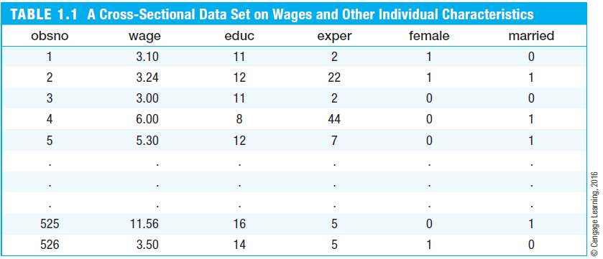
The Nature of Econometrics and Economic Data
Cross-sectional data set on wages and other characteristics
Indicator variables
(1 = yes, 0 = no)
Observation number
Hourly wage
Years of
education
Years of
experience

Slide 11
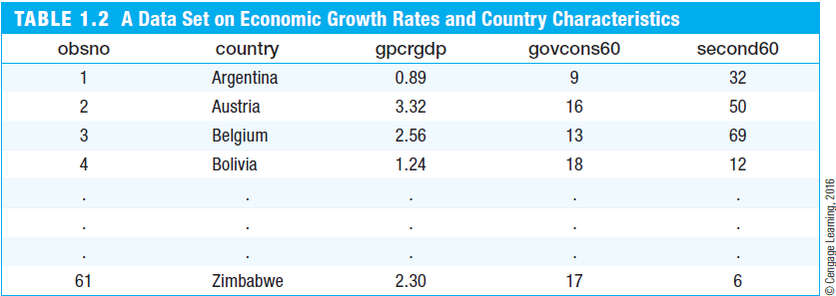
The Nature of Econometrics and Economic Data
Cross-sectional data on growth rates and country characteristics
Average growth rate of real
per capita GDP
Government consumption
as a percentage of GDP
Adult secondary
education rates

Slide 12
The Nature of Econometrics and Economic Data
Time series data
  Observations of a variable or several variables over time
  For example, stock prices, money supply, consumer price index, gross domestic product, annual homicide rates, automobile sales, …
  Time series observations are typically serially correlated
  Ordering of observations conveys important information
  Data frequency: daily, weekly, monthly, quarterly, annually, …
  Typical features of time series: trends and seasonality
  Typical applications: applied macroeconomics and finance

Slide 13
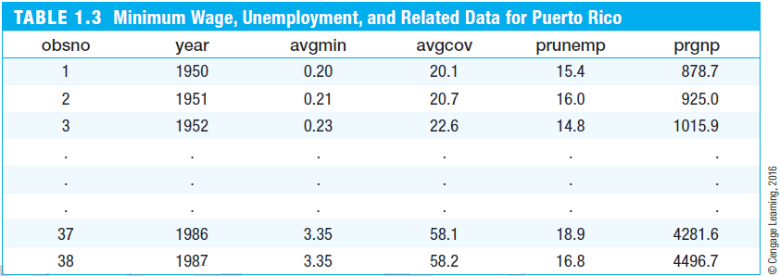
The Nature of Econometrics and Economic Data
Time series data on minimum wages and related variables
Average minimum
wage for the given year
Average
coverage rate
Unemployment
rate
Gross national
product

Slide 14
The Nature of Econometrics and Economic Data
Pooled cross sections
  Two or more cross sections are combined in one data set
  Cross sections are drawn independently of each other
  Pooled cross sections often used to evaluate policy changes
  Example:
    Evaluate effect of change in property taxes on house prices
    Random sample of house prices for the year 1993
    A new random sample of house prices for the year 1995
    Compare before/after (1993: before reform, 1995: after reform)

Slide 15
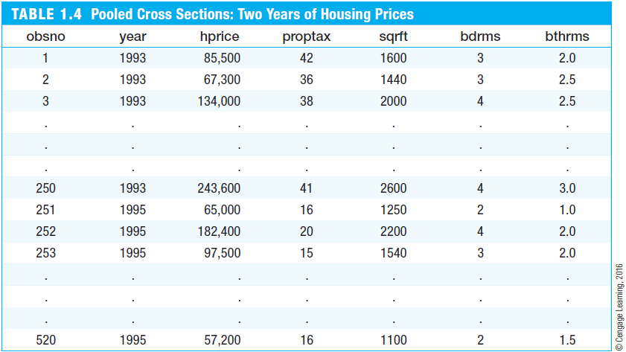
The Nature of Econometrics and Economic Data
Pooled cross sections on housing prices
Property tax
Size of house
in square feet
Number of bedrooms
Number of bathrooms
Before reform
After reform

Slide 16
The Nature of Econometrics and Economic Data
Panel or longitudinal data
  The same cross-sectional units are followed over time
  Panel data have a cross-sectional and a time series dimension
  Panel data can be used to account for time-invariant unobservables
  Panel data can be used to model lagged responses
  Example:
    City crime statistics; each city is observed in two years
    Time-invariant unobserved city characteristics may be modeled
    Effect of police on crime rates may exhibit time lag

Slide 17
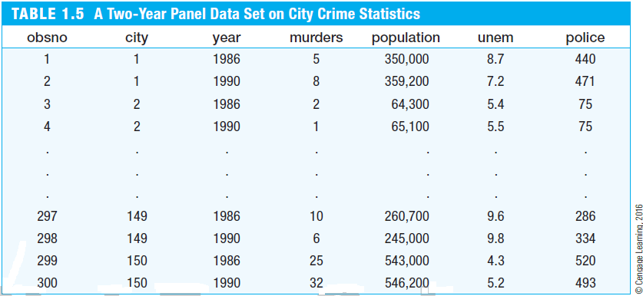
The Nature of Econometrics and Economic Data
Two-year panel data on city crime statistics
Each city has two time
series observations
Number of
police in 1986
Number of
police in 1990

Slide 18


The Nature of Econometrics and Economic Data
Causality and the notion of ceteris paribus
Most economic questions are ceteris paribus questions
It is important to define which causal effect one is interested in
It is useful to describe how an experiment would have to be designed to infer the causal effect in question
Definition of causal effect of on :
“How does variable change if variable is changed
but all other relevant factors are held constant”

Slide 19
The Nature of Econometrics and Economic Data
Causal effect of fertilizer on crop yield
  “By how much will the production of soybeans increase if one increases the amount of fertilizer applied to the ground”
  Implicit assumption: all other factors that influence crop yield such as quality of land, rainfall, presence of parasites etc. are held fixed
Experiment:
  Choose several one-acre plots of land; randomly assign different amounts of fertilizer to the different plots; compare yields
  Experiment works because amount of fertilizer applied is unrelated to other factors influencing crop yields

Slide 20
The Nature of Econometrics and Economic Data
Measuring the return to education
  “If a person is chosen from the population and given another year of education, by how much will his or her wage increase?”
  Implicit assumption: all other factors that influence wages such as experience, family background, intelligence etc. are held fixed
Experiment:
  Choose a group of people; randomly assign different amounts of education to them (infeasable!); compare wage outcomes
  Problem without random assignment: amount of education is related to other factors that influence wages (e.g. intelligence)

Slide 21
The Nature of Econometrics and Economic Data
Effect of law enforcement on city crime level
  “If a city is randomly chosen and given ten additional police officers, by how much would its crime rate fall?”
  Alternatively: “If two cities are the same in all respects, except that city A has ten more police officers than city B, by how much would the two cities‘ crime rates differ?”
Experiment:
  Randomly assign number of police officers to a large number of cities
  In reality, number of police officers will be determined by crime rate (simultaneous determination of crime and number of police)

Slide 22
The Nature of Econometrics and Economic Data
Effect of the minimum wage on unemployment
  “By how much (if at all) will unemployment increase if the minimum wage is increased by a certain amount (holding other things fixed)?”
Experiment:
  Government randomly chooses minimum wage each year and observes unemployment outcomes
  Experiment will work because level of minimum wage is unrelated to other factors determining unemployment
  In reality, the level of the minimum wage will depend on political and economic factors that also influence unemployment

Slide 23
The Nature of Econometrics and Economic Data
Testing predictions of economic theories
  Economic theories are not always stated in terms of causal effects
  For example, the expectations hypothesis states that long term interest rates equal compounded expected short term interest rates
  An implicaton is that the interest rate of a three-months T-bill should be equal to the expected interest rate for the first three months of a six-months T-bill; this can be tested using econometric methods

